Slide 1

MOSIP Decode Hackathon
OCR SYSTEM FOR TEXT EXTRACTION & VERIFICATION
Team Name (Registered on portal) :
Nirvana
Team leader :
Shreyansh Raj
Team Member :
Ashish Kumar
Aditi Tripathi

Slide 2
PROBLEM & MOTIVATION
Objectives
  Document Pre-processing & OCR Extraction
01
Slow processing
02
High human error rate
  Field Detection & Structured Data Mapping
03
Bottlenecks during registration
  Validation & Quality Assurance
04
Major issues in identity systems like MOSIP
  MOSIP Pre-Registration Integration

Slide 3
PROPOSED APPROACH
Limited Visibility
Manual Processes
Reactive Approach
  Enhance brightness/contrast
  Detect blur or glare
  Support multi-page PDFs and images
  PaddleOCR → printed content
  TrOCR transformer → handwritten entries
  Automatic language routing (Eng, Hin, Ara)
  Field mapping using patterns & semantic rules
  Convert raw text into a clean JSON structure
Verification Layer
  Compare extracted values with expected format
  Calculate per-field confidence scores

Slide 4
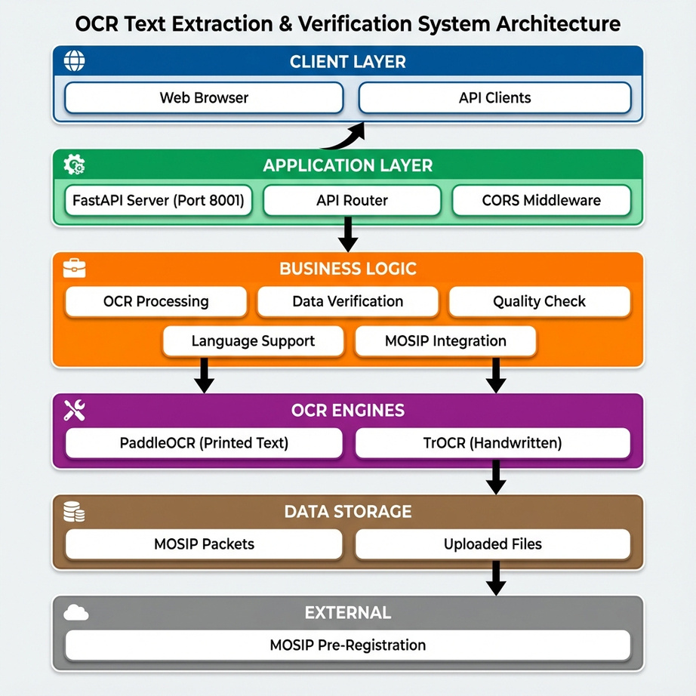
SYSTEM ARCHITECTURE
Frontend
Backend (FastAPI)
  OCR engines (PaddleOCR + TrOCR)
  Quality evaluation module
  Field matching and validation
  MOSIP Pre-Reg compatible data model
  Upload PDFs/images
  Preview extracted text
  Edit or correct fields
  View confidence indicator
Outputs
  Structured JSON
  Confidence map
  Capture quality rating
  Packet-ready data for MOSIP

Slide 5
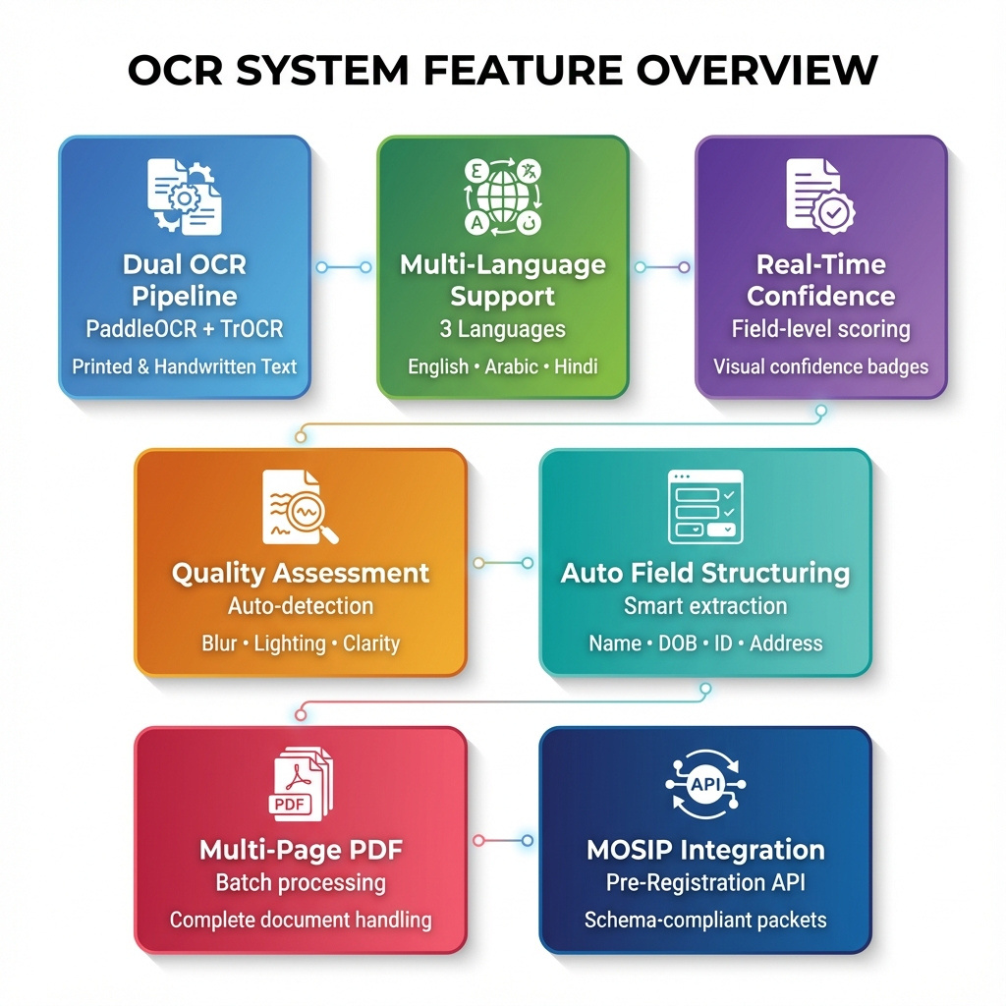
KEY FEATURES
  Dual OCR pipeline for printed + handwritten text
  Supports multiple languages
  Real-time confidence overlays on the document
  Blur, lighting, and clarity scoring
  Automatic structuring of fields (name, DOB, ID, address…)
  Multi-page PDF handling
  Compatible with MOSIP Pre-Registration API schema

Slide 6
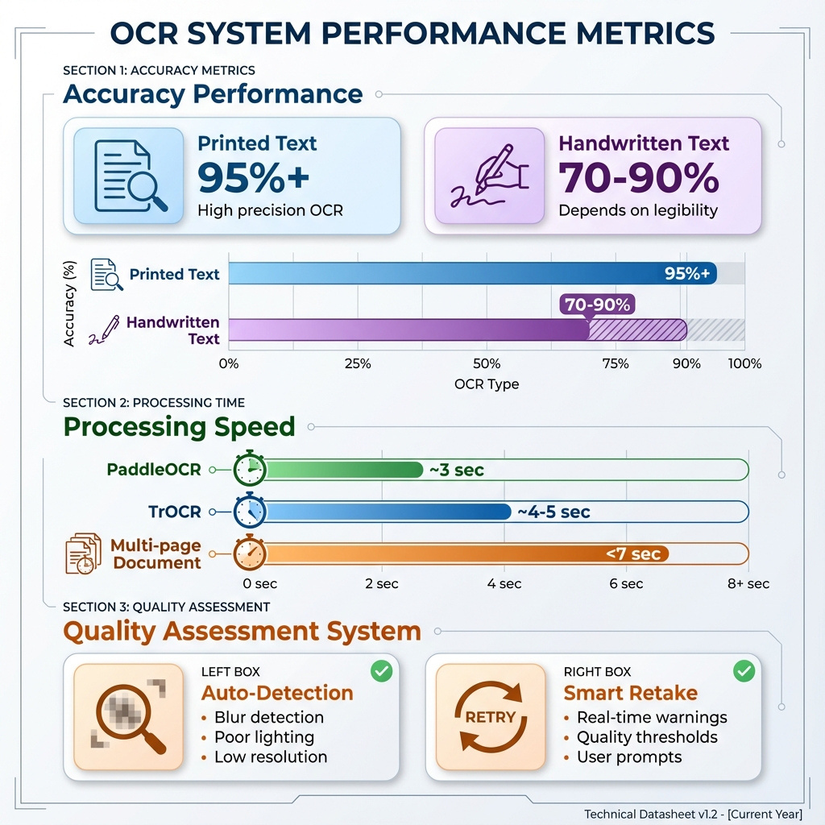
RESULTS & PERFORMANCE
Accuracy
  Printed text: 95%+
  Handwritten text: 70–90% depending on legibility
.
Processing Time
  PaddleOCR: ~3 sec
  TrOCR: ~4–5 sec
  Full document (multi-page): under 7 seconds
Quality Assessment
  Successfully identifies blurry, dark, or low-quality captures
  Helps the user retake poor scans before extraction

Slide 7
IMPACT & CONCLUSION
  Reduces manual data entry by up to 80%
  Minimizes errors during form filling
  Makes registration smoother and more reliable
  Enables inclusion for citizens using handwritten or mixed-language documents
  Generates MOSIP-compliant data for hassle-free integration
Conclusion
A lightweight, offline-friendly, multi-OCR system that streamlines document processing and strengthens digital identity workflows — especially for MOSIP deployments.

Slide 8
THANK YOU

